Slide 1

Capstone Project-II
Yes Bank Stock Closing Price Prediction By Kaushal Kumar Jha

Slide 2

Points For Discussion
Problem Statement
Data Summary
Data cleaning
Exploratory Data Analysis
Correlation and VIF Analysis
Model Training
Conclusion

Slide 3

1. Problem Statement
YES Bank is a well-known bank in the Indian financial domain. Since 2018, it has been in the news because of the fraud case involving Rana Kapoor.
We were interested to know that either ML model can predict the impact on stock price due to any fraud cases.
So we have performed regression analysis to make future prediction using various machine learning models and selected one model as best model after comparing them using evaluation matrices and this model will be going to use for future prediction.

Slide 4
2.Data Summary Data Set:- In Yes Bank Stock Price data set contains 185 rows and 5 columns which includes Date, Open, High, Low and Close. Date:- The date of record finalizes the transfer of the stock's ownership Open:- Open Price is the price at which the financial security opens in the market when trading begins. It may or may not be different from the previous day's closing price. The security may open at a higher price than the closing price due to excess demand of the security. High:-High is the highest price at which a stock traded during a period. Low:- Low is the lowest price at which stock traded during a period. Close:- Closing price of stock is the price at which the share closes at the end of trading hours of the stock market.

Slide 5
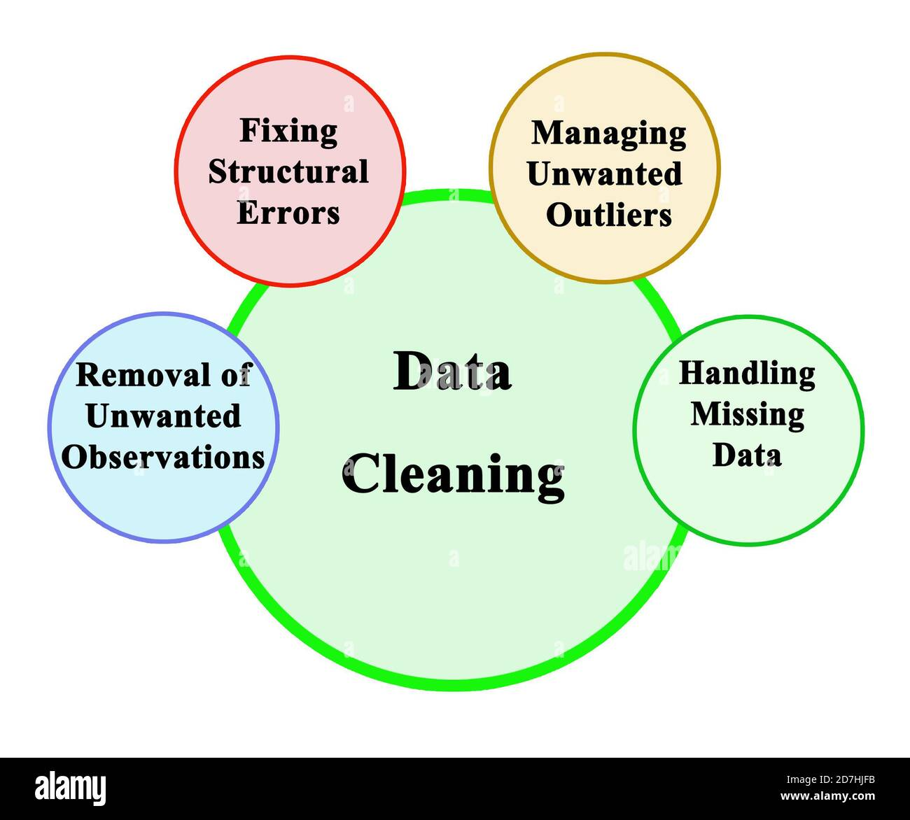
3. Data Cleaning In this we performed: 1.Null value Treatment 2.Duplicate Treatment 3.Data Format change 1.Null Value Treatment : In given dataset no null value was there. 2. Duplicate Treatment :There was no duplicate data in dataset. 3.Data Format change: We have changed datatype of Date column from object to time64 format.

Slide 6
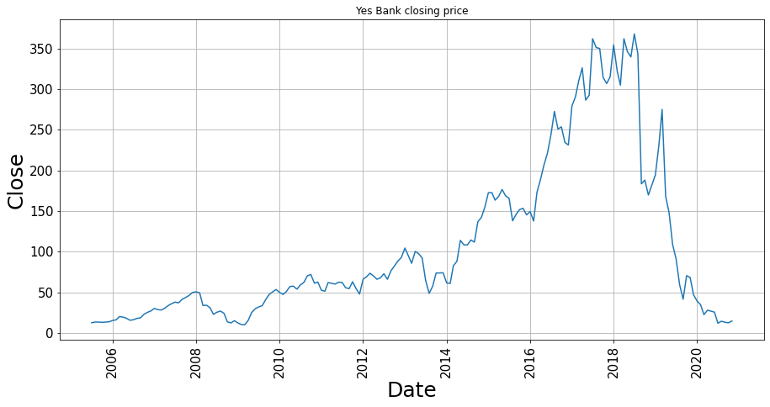
4.Exploratory Data Analysis(EDA) Univariate Analysis
From above graph it is clear that, trend was continuously increasing from 2009 till 2018. After 2018 it started to decrease due to fraud case of Rana Kapoor.

Slide 7
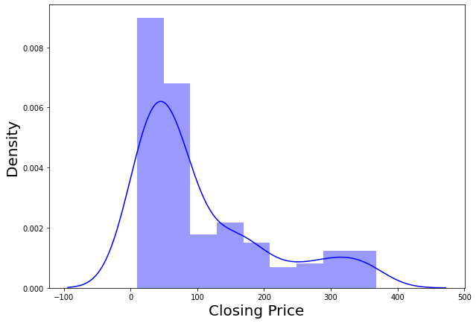
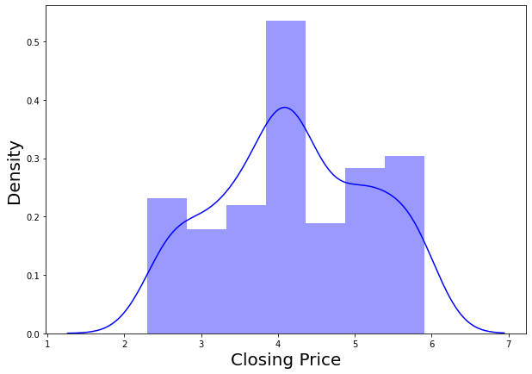
EDA continue..
Distribution of Close:- Distribution of target variable(Closing Price) was right skewed so we performed log transformation to make it normal
Before Log Transformation
After Transformation

Slide 8
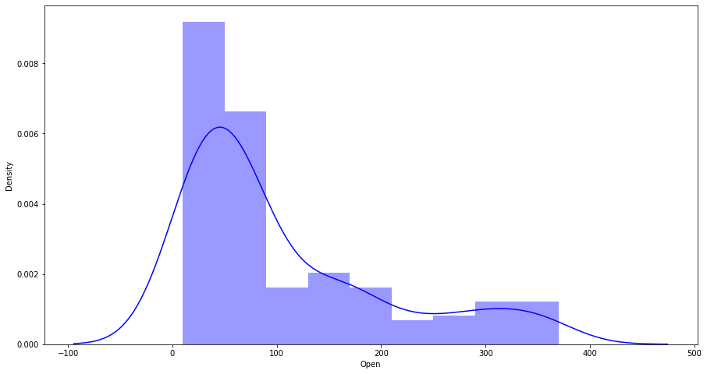
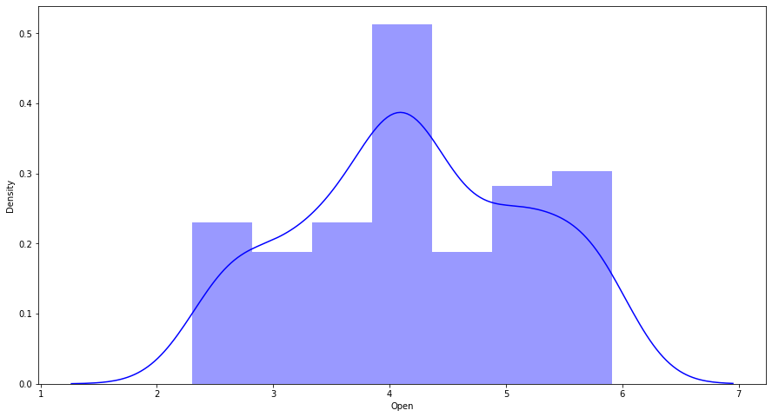
EDA Continue..
Distribution Of All Independent Variables(Open, High and Low)
Distribution of Open
Before Log Transformation
After Transformation

Slide 9
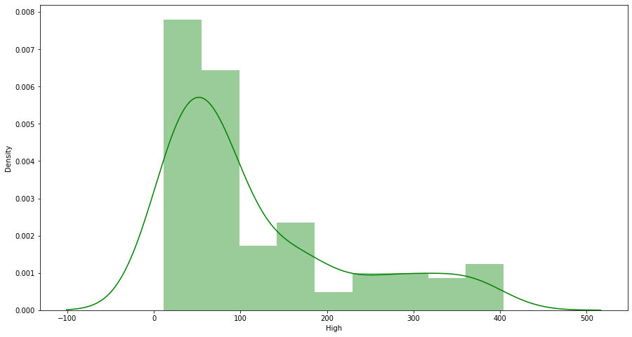
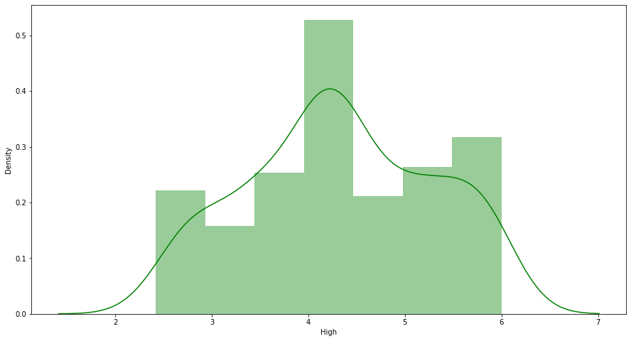
EDA continue…
Distribution of High
Before Transformation
After Transformation

Slide 10
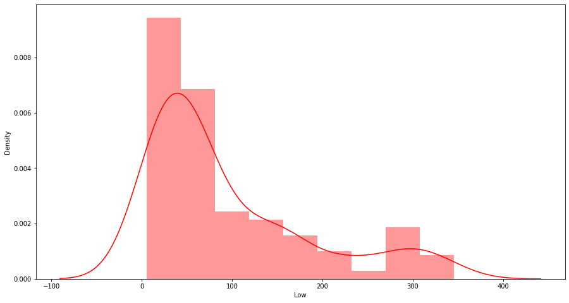
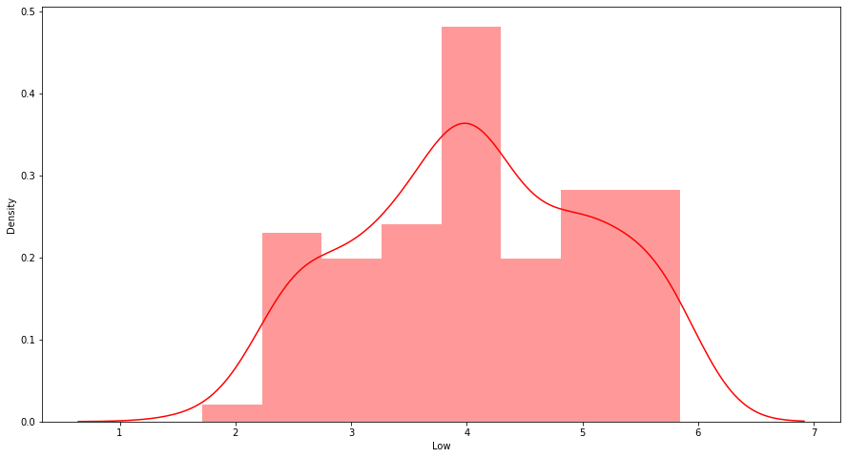
EDA continue…
Distribution of Low
Before Transformation
After Transformation
We have seen that all variables was right skewed so we have performed log transformation and after that all became normal.

Slide 11
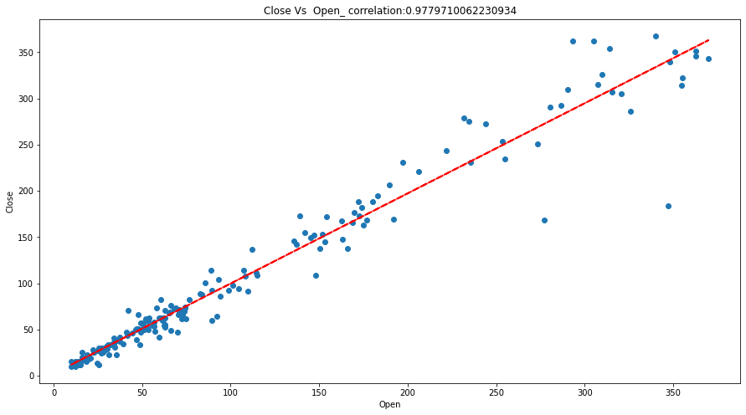
EDA Continue…
Bivariate Analysis: Now we will see the relationship between dependent and independent variable using scatter plot.
Close Vs Open

Slide 12
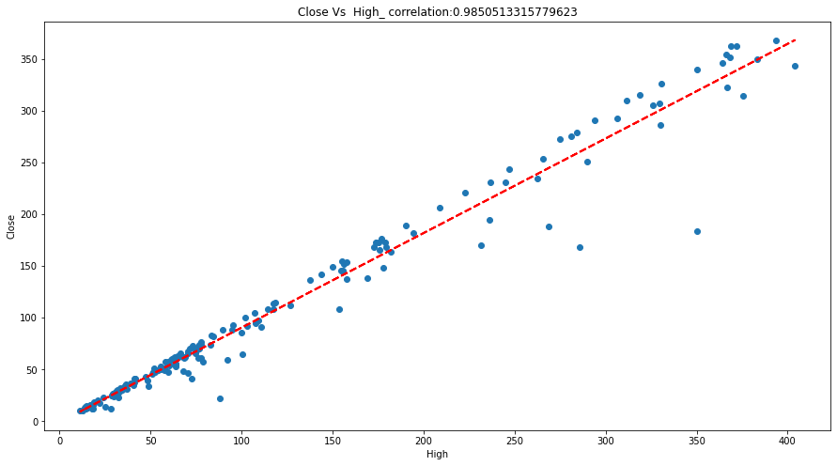
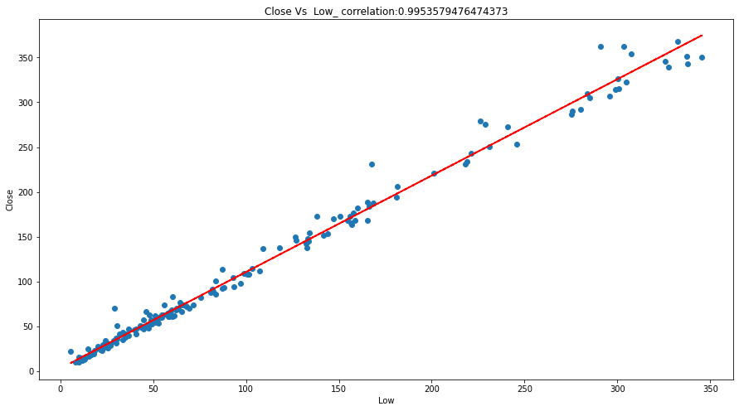
EDA Continue…
Close Vs High
Close Vs Low

Slide 13
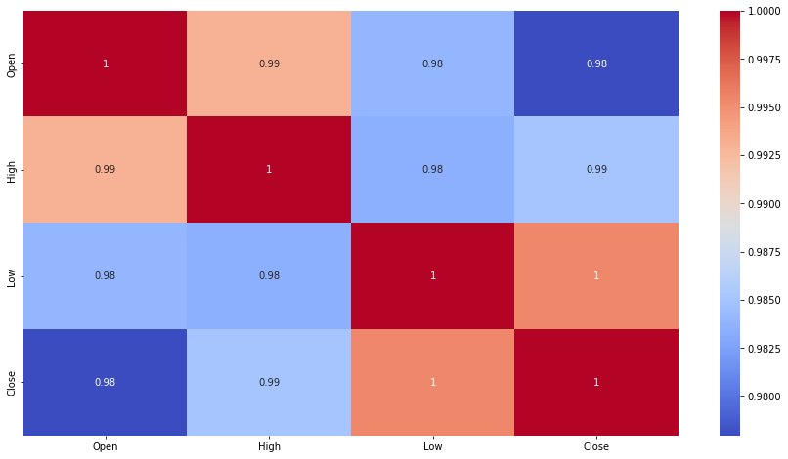
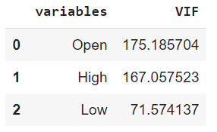
5.Correlation And VIF Analysis.
Correlation HeatMap
We can see that all variables are highly correlated and also we can see that VIF scores are very high for all our features which means there is a multicollinearity between our independent variables.
As we have limited features, dropping any one of them will result in loss of important data which are essential for accurate model prediction and it will result in bad model.

Slide 14
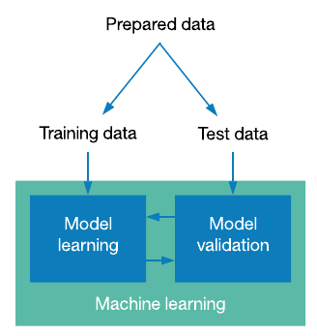
6.Model Training
Train Test Split
Train Test Split is used to split the dataset in Train and Test Sets.
Train Set is used to train the model.
Test set is used to test the performance of model.
80% of data is used to train the model and only 20% is used for testing purpose.

Slide 15
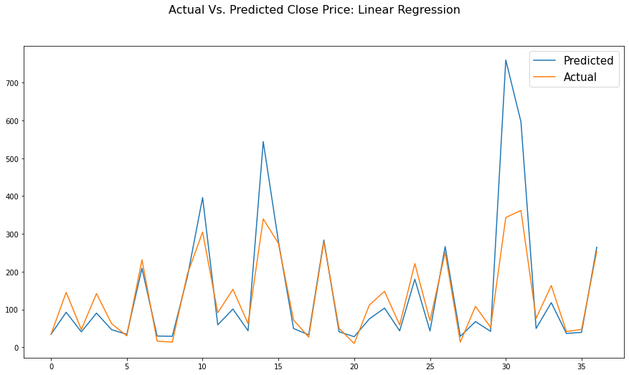
1.Linear Regression
Linear regression is a popular and uncomplicated algorithm used in data science and machine learning.
Linear regression shows a linear relationship between dependent and independent variables.
Evaluation Matric
MSE | RMSE | MAE | MAPE | R2 Score
0.032 | 0.1788 | 0.1457 | 0.087 | 0.8283

Slide 16
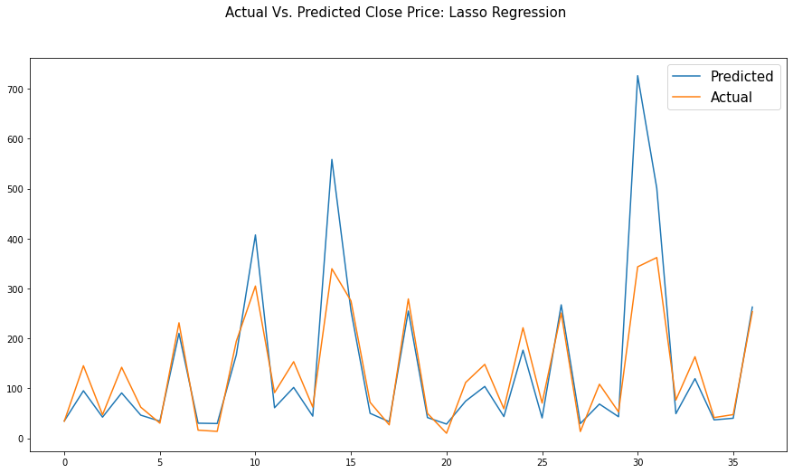
2. Lasso Regression
It is a regression analysis method that performs both variable selection and regularization in order to enhance the prediction accuracy and interpretability of model.
This regression perform L1 Regularization.
Evaluation Matrics
Before Cross Validation
MSE | RMSE | MAE | MAPE | R2 Score
0.0316 | 0.1778 | 0.1463 | 0.0876 | 0.8303
After Cross Validation
MSE | RMSE | MAE | MAPE | R2 Score
0.0315 | 0.1775 | 0.1459 | 0.0877 | 0.8308

Slide 17

3.Ridge Regression
Ridge regression is a model tuning method that is used to analyse any data that suffers from multicollinearity.
This method performs L2 regularization. When the issue of multicollinearity occurs, least-squares are unbiased, and variances are large, this results in predicted values being far away from the actual values.
Evaluation Matrics
Before Cross Validation
MSE | RMSE | MAE | MAPE | R2 Score
0.0319 | 0.1786 | 0.1453 | 0.0869 | 0.8288
After Cross Validation
MSE | RMSE | MAE | MAPE | R2 Score
0.0317 | 0.1781 | 0.1464 | 0.0874 | 0.8298

Slide 18
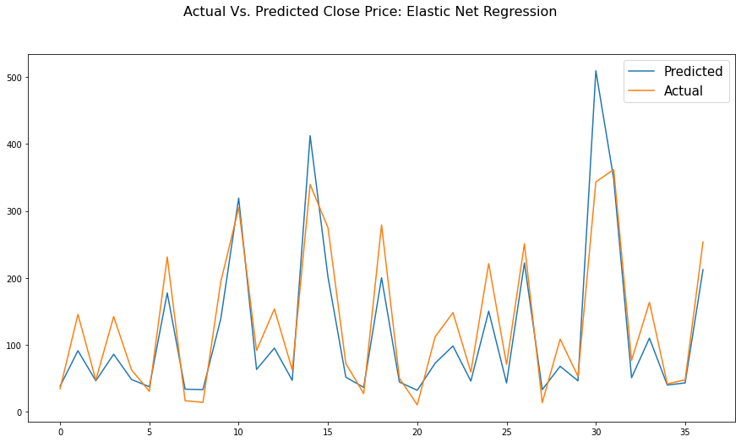
4.Elastic Net Regression
Elastic net linear regression uses the penalties from both the lasso and ridge techniques to regularize regression models.
The technique combines both the lasso and ridge regression methods by learning from their shortcomings to improve the regularization of statistical models.
Evaluation Matrics
Before Cross Validation
MSE | RMSE | MAE | MAPE | R2 Score
0.0344 | 0.1854 | 0.1514 | 0.0924 | 0.8155
After Cross Validation
MSE | RMSE | MAE | MAPE | R2 Score
0.0316 | 0.1778 | 0.1462 | 0.0876 | 0.8304

Slide 19
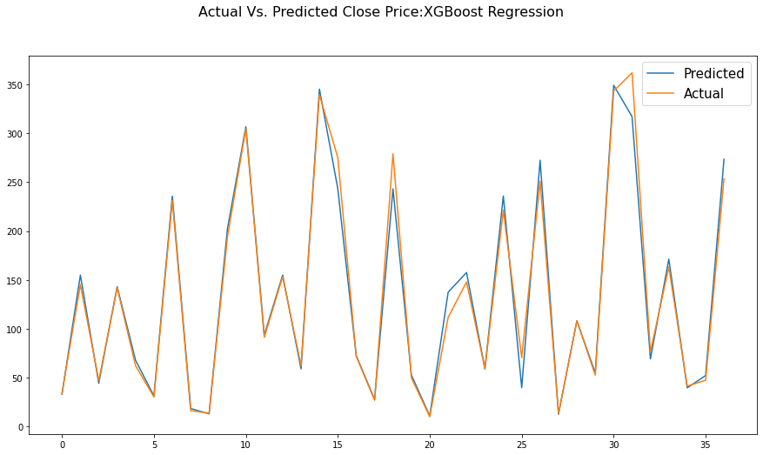
5.XG Boost Regression
XGBoost, which stands for Extreme Gradient Boosting, is a scalable, distributed gradient-boosted decision tree (GBDT) machine learning library.
It provides parallel tree boosting and is the leading machine learning library for regression, classification, and ranking problems.
EVALUATION MATRICS
MSE | RMSE | MAE | MAPE | R2 Score
0.0027 | 0.0518 | 0.0316 | 0.0174 | 0.9856

Slide 20
Evaluation Matric Of All Models
MODEL | MSE | RMSE | MAE | MAPE | R2 SCORE
Linear Regression | 0.032 | 0.1788 | 0.1457 | 0.087 | 0.8283
Lasso Regression (CV) | 0.0315 | 0.1775 | 0.1459 | 0.0877 | 0.8308
Ridge Regression (CV) | 0.0317 | 0.1781 | 0.1464 | 0.0874 | 0.8298
Elastic Net Regression (CV) | 0.0316 | 0.1778 | 0.1462 | 0.0876 | 0.8304
XG Boost Regression | 0.0027 | 0.0518 | 0.0316 | 0.0174 | 0.9856

Slide 21
7.Conclusions
Stock Price prediction with the help of Machine Learning models is less time consuming and also it gives good performance.
Stock price was continuously increasing till 2018 after that it decreases due to fraud case of Rana Kapoor.
All independent variables (Open, High& Low) are extremely correlated with dependent variable (Close).
All independent variables are highly correlated with each other (Multicollinearity).
Distribution of all independent and dependent variables was right skewed and after log transformation it became Normal.
We have compared 5 models (Linear Regression, Lasso Regression, Ridge Regression, Elastic Net Regression, and XG Boost Regression) on the basis of RMSE and MAPE.
RMSE and MAPE are mostly used as evaluation metrics to measure forecast accuracy.
XG Boost Regression is best model among all five models with lowest RMSE=0.0518, and MAPE=0.0174 than other models and also it has highest r2 score (r2 score=0.9856) than other models.

Slide 22


